Slide 1
Fixed point addition and subtraction
Computer System Architecture
By
M. Morris Mano
Prof.S.Meenatchi, SITE, VIT

Slide 2
Introduction
Algorithm – solution to any problem that is stated by a finite number of well-defined procedural steps.
Algorithms for addition, subtraction, multiplication and division
  Fixed point binary data in signed magnitude representation
  Fixed point binary data in signed 2’s complement representation
  Floating point binary data.
Prof.S.Meenatchi, SITE, VIT

Slide 3
Addition (Subtraction) algorithm with signed magnitude data
When signs of A and B
  Are identical (different)
    Add magnitudes
    Attach the sign of A to the result.
  Are different (identical)
    Compare the magnitudes and subtract smaller from larger.
      if A > B, subtract B from A, put the sign of A for the result.
      If A < B, subtract A from B, put the complement of the sign of A for the result.
Prof.S.Meenatchi, SITE, VIT

Slide 4
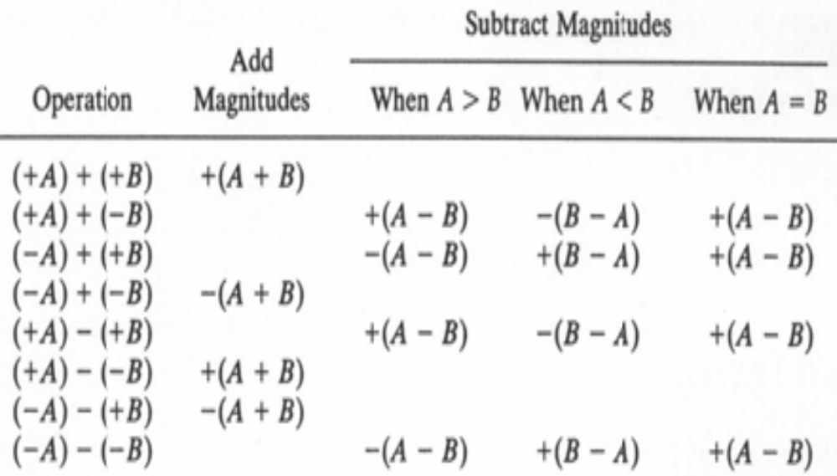
Addition and Subtraction of signed magnitude numbers
Prof.S.Meenatchi, SITE, VIT

Slide 5
Hardware implementation for signed magnitude addition and subtraction
A and B Registers – used to store magnitude of 2 numbers.
A_{s} and B_{s} Flip-flops – used to hold corresponding sign.
Result is transferred to A and A_{s.}
A and A_{s} together form an accumulator register.
Parallel-adder - to perform the microoperation A+B.
Comparator circuit - to establish if A>B, A=B or A<B.
Two parallel-subtractor circuit - to perform the microoperation A-B and B-A.
XOR gate – to determine sign relationship with A_{s} and B_{s} .
This procedure needs more equipments like magnitude comparator, an adder, and two subtractor.
Prof.S.Meenatchi, SITE, VIT

Slide 6
Another procedure
It requires less equipment.
Subtraction – accomplished by means of complement and add.
Comparison – determined from end carry after the subtraction.
Use 2’s complement for subtraction and comparison – efficient procedure that requires only an adder and a complementer.
Prof.S.Meenatchi, SITE, VIT

Slide 7
Hardware for signed magnitude addition and subtraction
It consists of A and B Registers and As and Bs Flip-flops.
Parallel adder – perform A+B.
Complementor – provides output of B or the complement of B depend on the state of mode control M.
Output carry – transferred to flip-flop E.
Add-overflow flip-flop AVF holds the overflow when A+B.
B_{S}
B Register
AVF
Complementer
M (Mode Control)
Output
carry
Parallel adder
E
Input carry
S
A_{S}
A Register
Load Sum
Prof.S.Meenatchi, SITE, VIT

Slide 8
Hardware for signed magnitude addition and subtraction
Subtraction – done by adding A to the 2’s complement of B.
E – checked to determine the relative magnitude of the 2 numbers.
Complementor – consists of XOR gate.
Parallel adder – consists of full-adder circuit.
M signal applied to the input carry of the adder.
If M=0 – output of B is transferred to the adder, input carry = 0, output of adder =A+B.
If M=1 – 1’s complement of B is transferred to the adder, input carry = 1, output of adder =A+ B +1. This is equal to A+2’s complement of B, which is equivalent to A-B.
Prof.S.Meenatchi, SITE, VIT

Slide 9
Hardware algorithm
Two signs A_{s} and B_{s} compared by an XOR gate.
If output=0, signs are identical.
If output=1, signs are different.
For add operation – if signs are identical then magnitudes are added.
For subtraction operation –if signs are different then magnitudes are added.
Magnitudes are added with microoperation EA ← A + B .
After addition E, A contains the carry and sum respectively.
If E=1, addition constitute overflow and it is transferred to AVF.
Prof.S.Meenatchi, SITE, VIT

Slide 10
Hardware algorithm cont..
For add operation – if signs are different then magnitudes are subtracted.
For subtraction operation – if signs are identical then magnitudes are subtracted.
Magnitudes are subtracted by adding A to the 2’s complement of B with microoperation EA ← A + B + 1.
During subtraction no overflow can occur. So AVF=0.
E=0 indicates that A ≥ B.
  A contains correct result.
  Sign of the result is same as sign of A, so no sign change is required.
  If result is 0 then A_{s} must be +ve to avoid –ve 0.
E=1 indicates that A<B.
  It is necessary to take 2’s complement of A.
  Sign of the result is complement sign of A.
Prof.S.Meenatchi, SITE, VIT

Slide 11
Flow chart for add and subtract operations
Subtract operation
Add operation
Minuend in A
Subtrahend in B
Augend in A
Addend in B
= 0
A_{S} + B_{S}
= 1
= 1
A_{S} + B_{S}
= 0
A_{S} ≠ B_{S}
A_{S} = B_{S}
A_{S} ≠ B_{S}
A_{S} = B_{S}
EA ← A + B + 1
AVF ← 0
EA ← A + B
= 0
E
= 1
A < B
A ≥ B
AVF ← E
≠ 0
= 0
A ← A
A
A ← A + 1
A_{S} ← A_{S}
A_{S} ← 0
END
(Result in A and A_{S})
Prof.S.Meenatchi, SITE, VIT

Slide 12
Problems
Mark each individual path in the flow chart by a number and then indicate the overall path that the algorithm takes when the following signed magnitude numbers are computed. In each case give the value of AVF. The left most bit in the following numbers represents the sign bit
  0 1001101 + 0 0111111
  1 011111 + 1 101101
  0 101101 – 0 011111
  0 101101 – 0 101101
  1 011111 – 0 101101
Prof.S.Meenatchi, SITE, VIT

Slide 13
Signed magnitude addition
1
1
1
1
1
0
1
0
1
1
0
1
+
0
0
1
1
1
1
1
0
0
0
1
1
0
0
E = AVF = 1
Prof.S.Meenatchi, SITE, VIT

Slide 14
Signed 2’s complement addition and subtraction
Left most bit – represent sign bit.
0 for +ve and 1 for –ve.
-ve numbers are represented in 2’s complement form.
Addition in 2’s complement:
  Add the numbers including sign bits.
  Carry-out of the sign-bit – discarded.
Subtraction in 2’s complement:
  Take 2’s complement of subtrahend and then add it to the minuend.
Overflow detected by – last 2 carry out of addition.
2 carries are applied to XOR.
If output=1 – overflow is detected.
Prof.S.Meenatchi, SITE, VIT

Slide 15
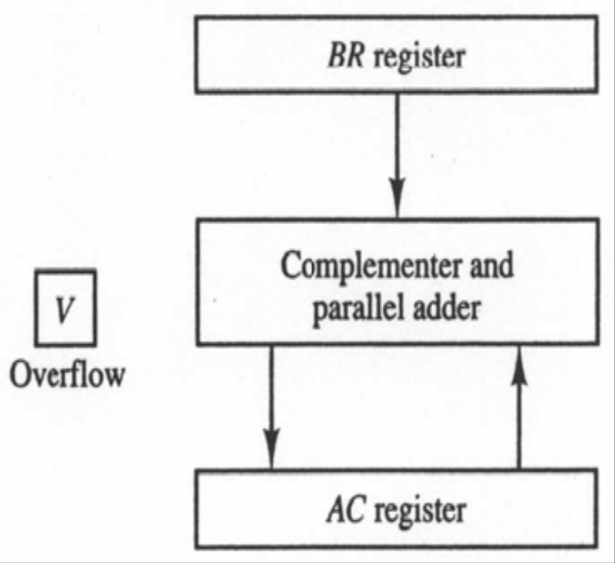
Hardware for signed 2’s complement addition and subtraction
Sign bits are not separated.
Name the A register AC and B register BR.
Leftmost bit in AC and BR represent the sign bit.
2 sign bits are added and subtracted with other bits using complementer and parallel adder.
If any overflow – over-flow flip-flop V is set to 1. Otherwise 0.
Output carry is discarded.
Prof.S.Meenatchi, SITE, VIT

Slide 16
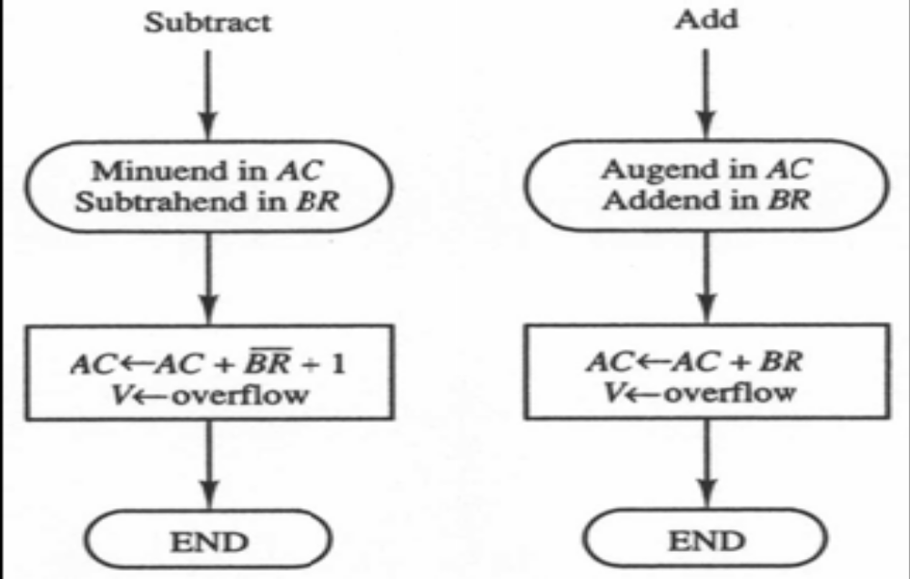
Signed 2’s complement addition and subtraction
Prof.S.Meenatchi, SITE, VIT

Slide 17
Problems
Perform the arithmetic operations below with binary numbers and with negative numbers in signed 2’s complement representation. Use seven bits to accommodate each number together with its sign. In each case, determine if there is an overflow by checking the carries into and out of the sign bit position
  (+35) + (+40)
  (-35) + (-40)
  (-35) – (+40)
Prof.S.Meenatchi, SITE, VIT

